Slide 1




NEXT GEN EMPLOYABILITY PROGRAM
Creating a future-ready workforce
Team Members
College Name
Student Name : R. Saranya
Student ID : 511321205031
Kingston Engineering College

Slide 2

CAPSTONE PROJECT SHOWCASE
Project Title
Building Bus Reservation System using Python and Django
Abstract | Problem Statement | Project Overview | Proposed Solution | Technology Used | Modelling & Results | Conclusion

Slide 3
Abstract
The Bus Reservation System (BRS) is a crucial component of modern transportation infrastructure, facilitating the efficient booking and management of bus tickets for passengers. In this abstract, we present an overview of our innovative approach to designing and implementing a user-centric BRS, aimed at enhancing the overall experience for both passengers and service providers.
Our BRS employs state-of-the-art technology to streamline the reservation process, offering users a seamless and intuitive interface accessible through various platforms including web and mobile applications. Utilizing advanced algorithms, the system optimizes seat allocation, ensuring maximum occupancy while maintaining passenger comfort and safety.
Key features of our BRS include real-time availability updates, flexible booking options, and secure payment processing. Passengers can easily search for routes, select preferred seats, and complete transactions with confidence. Additionally, the system provides timely notifications and reminders to keep users informed about their travel itinerary.
For bus operators, our BRS offers comprehensive management tools to monitor reservations, track bus schedules, and analyze performance metrics. This enables operators to make informed decisions, optimize fleet utilization, and enhance operational efficiency.
In summary, our user-centric BRS represents a significant advancement in bus reservation technology, offering a convenient and reliable solution for passengers and operators alike. Through continuous innovation and refinement, we are committed to delivering a superior travel experience while driving efficiency and profitability in the transportation industry.
Source :

Slide 4
Problem Statement
Complexity and Inefficiency: Many existing BRS platforms are cumbersome and difficult to navigate, requiring users to go through multiple steps to complete a booking, leading to user frustration and potential abandonment of the reservation process.
Limited Accessibility: Some BRS platforms lack compatibility with mobile devices or do not offer user-friendly mobile applications, restricting passengers' ability to book tickets on-the-go and limiting the overall reach of the system.
Inaccurate Information and Availability: Outdated or inaccurate real-time updates on seat availability, bus schedules, and route information can lead to overbooking, double bookings, and customer dissatisfaction.
Lack of Personalization: Current BRS often do not provide personalized recommendations or preferences based on users' travel history, preferences, or loyalty programs, missing opportunities to enhance the user experience and foster customer loyalty.
Security Concerns: Inadequate security measures and vulnerabilities in payment processing can expose users to potential risks such as fraud and unauthorized access to personal and financial information.
Inefficient Management Tools for Operators: Bus operators face challenges in efficiently managing reservations, optimizing seat allocation, and analyzing performance data due to limited or outdated management tools provided by existing BRS platforms.
Source :

Slide 5
Project Overview
Introduction: The Bus Reservation System (BRS) project aims to design, develop, and implement an efficient and user-friendly online platform for booking bus tickets. This system will cater to both passengers looking to book bus tickets and bus operators seeking effective management tools to streamline their operations.
Objective: The primary objective of the BRS project is to create a comprehensive and user-centric reservation system that addresses the existing challenges in the transportation industry. The system will focus on enhancing the booking experience for passengers while providing bus operators with robust tools for managing reservations, optimizing seat allocation, and analyzing performance metrics.
Conclusion: The Bus Reservation System (BRS) project aims to revolutionize the bus booking experience by offering a seamless, secure, and personalized platform for passengers while empowering bus operators with advanced management tools and analytics. By addressing the existing challenges and incorporating innovative features, the BRS project strives to enhance efficiency, profitability, and customer satisfaction in the transportation industry.
Source :

Slide 6
Proposed Solution
User-Centric Interface:
Intuitive and responsive user interfaces accessible via web and mobile platforms.
Easy-to-navigate booking process with interactive route maps, real-time seat availability, and secure payment options.
Personalized user profiles for managing bookings, preferences, and notifications.
Real-Time Updates and Notifications:
Integration with GPS and traffic data to provide accurate and real-time updates on bus schedules, arrivals, and delays.
Automated notifications to passengers regarding booking confirmations, schedule changes, and other relevant information.
Dynamic Routing and Scheduling:
Intelligent algorithms for dynamic route optimization and scheduling based on real-time demand, traffic conditions, and operational constraints.
Adaptive scheduling mechanisms to adjust routes and frequencies in response to changing passenger demand patterns.
Source :

Slide 7
Adaptive scheduling mechanisms to adjust routes and frequencies in response to changing passenger demand patterns.
Flexible Ticketing Options:
Multiple ticketing options including single rides, multi-ride passes, and subscription-based models to cater to diverse passenger needs.
Integration with contactless payment systems and digital wallets for seamless and secure transactions.
Analytics and Performance Monitoring:
Comprehensive analytics dashboard for monitoring key performance indicators (KPIs) such as booking rates, occupancy levels, and on-time performance.
Advanced data analytics capabilities for predictive maintenance, demand forecasting, and route optimization.
Accessibility and Inclusivity:
Accessibility features such as screen reader support, language translation, and wheelchair-accessible seating options to ensure inclusivity for all passengers.
Integration with transportation accessibility standards and guidelines to enhance the overall accessibility of the system.
Source :

Slide 8
Scalability and Interoperability:
Scalable architecture designed to accommodate future growth and expansion of services.
Open APIs and standards-based protocols for seamless integration with third-party applications, transit agencies, and mobility service providers.
Benefits of the Proposed Solution:
Enhanced passenger experience: The user-centric design and real-time updates ensure a seamless and convenient booking experience for passengers, leading to increased satisfaction and loyalty.
Improved operational efficiency: Dynamic routing, scheduling, and analytics enable better resource utilization, reduced operational costs, and optimized revenue generation for service providers.
Sustainability and environmental impact: By promoting public transportation usage and optimizing bus routes, the system contributes to reducing traffic congestion, carbon emissions, and environmental footprint.
Future-ready infrastructure: The scalable and interoperable architecture ensures adaptability to evolving technological trends and industry standards, future-proofing the system for long-term sustainability and growth.
In conclusion, the proposed next-generation bus reservation system represents a significant advancement in the realm of public transportation, offering a transformative solution to meet the evolving needs of passengers and service providers alike. With its user-centric design, real-time capabilities, and advanced analytics, the system sets a new standard for efficiency, reliability, and sustainability in the transportation.
Source :

Slide 9


Technology Used
Front-end
Back-end
Source :

Slide 10
Modelling & Results
Booking Rate Analysis: Modeling the booking rate over time to understand booking patterns, peakperiods, and trends. This could involve statistical analysis and time series modeling techniques topredict future booking demand.
Seat Occupancy Forecasting: Predicting seat occupancy rates for different routes and schedulesusing regression or machine learning models. This information can help optimize resource allocationand scheduling.
Revenue Projection: Modeling revenue projections based on ticket sales, considering factors such aspricing strategies, seasonal variations, and promotional campaigns.
Route Optimization: Using optimization algorithms to model and optimize bus routes, consideringfactors such as distance, travel time, passenger demand, and operational constraints.
Customer Satisfaction Analysis: Modeling customer feedback data to analyze satisfaction levels,identify areas for improvement, and measure the impact of system changes on passenger experience.
Operational Efficiency Metrics: Modeling key performance indicators (KPIs) such as on-timeperformance, turnaround time, and fleet utilization rate to assess the overall efficiency of the busreservation system.
Resource Allocation Simulation: Conducting simulation studies to model and evaluate differentresource allocation strategies, such as bus and driver assignments, to minimize cost.
Source :

Slide 11
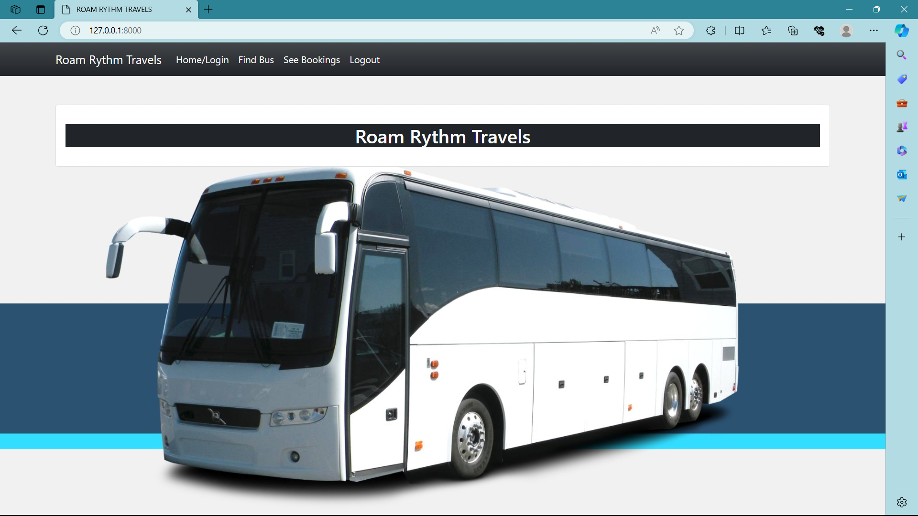
Homepage

Slide 12
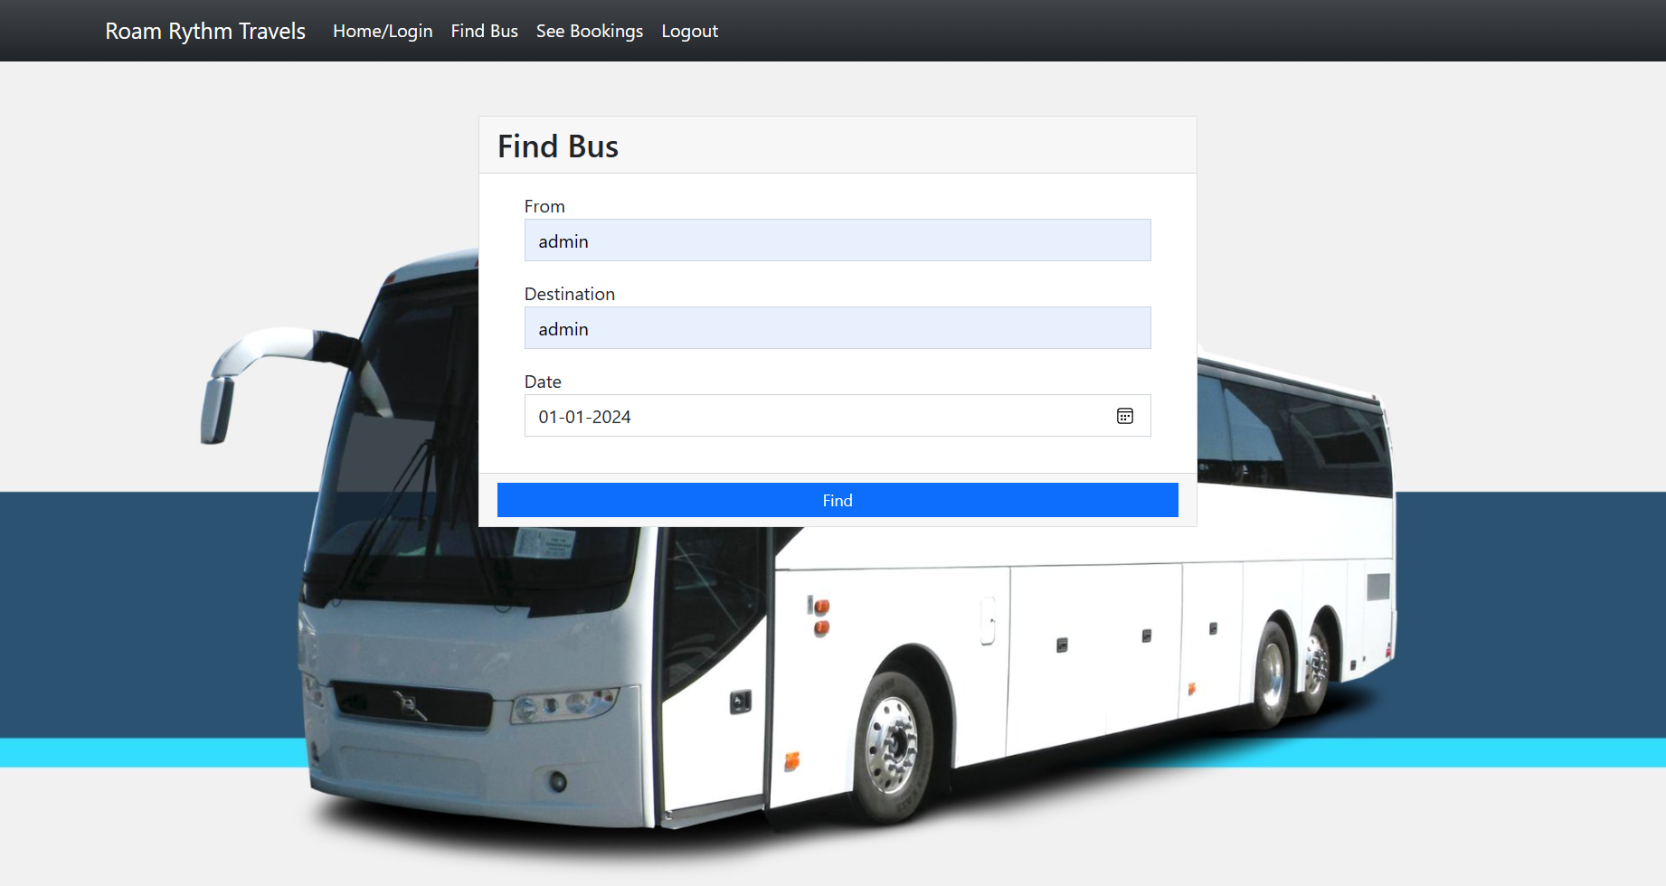
About-Us-Page

Slide 13
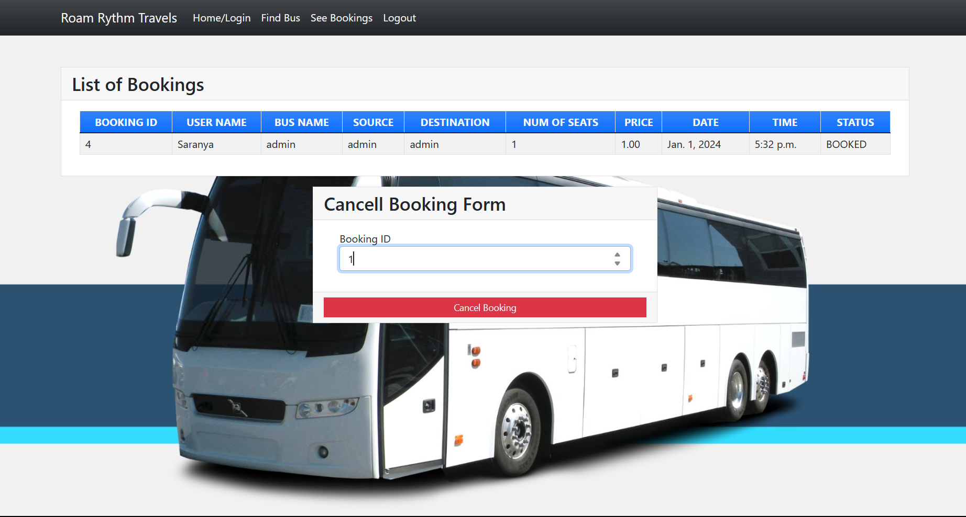
Service-Page

Slide 14
Departments-Page

Slide 15
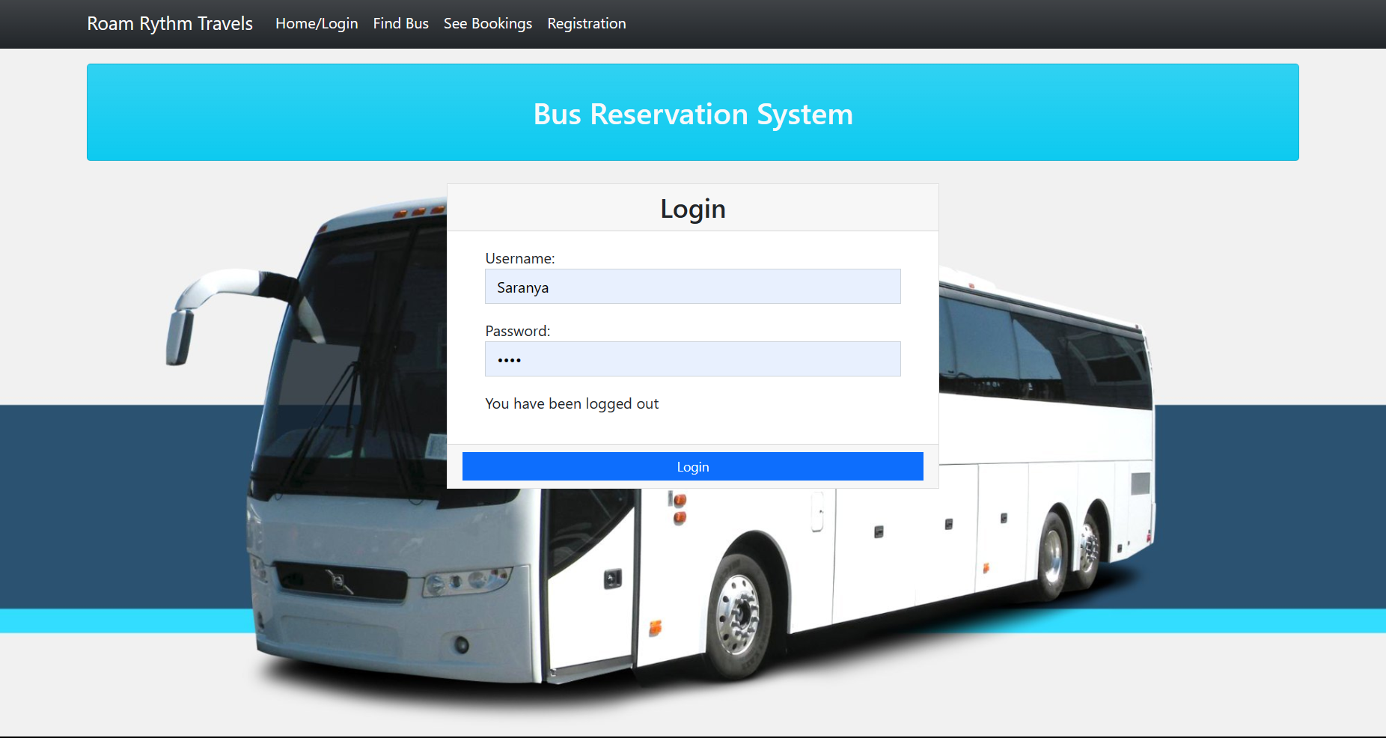
Blog-Page

Slide 16
Future Enhancements:
Predictive Maintenance Integration: Incorporating predictive maintenance algorithms that utilize real-time data from buses to anticipate maintenance needs, reducing downtime and improving fleet reliability.
Augmented Reality (AR) Seat Selection: Implementing AR technology to allow passengers to visualize and select their seats before booking, enhancing the booking experience and reducing confusion during boarding.
Voice-Activated Booking: Introducing voice-activated booking capabilities to enable passengers to make reservations and access information hands-free, catering to individuals with disabilities and improving accessibility.
Integration with Smart City Initiatives: Collaborating with smart city initiatives to integrate bus reservation systems with broader urban planning efforts, facilitating seamless connectivity between public transportation, bike-sharing programs, and other mobility solutions.
Carbon Emission Tracking: Incorporating carbon emission tracking features into the reservation system to provide passengers with insights into the environmental impact of their travels and incentivizing eco-friendly transportation choices.
Dynamic Routing for Electric Buses: Developing dynamic routing algorithms specifically tailored for electric buses to optimize charging station utilization and minimize range anxiety, supporting the transition to sustainable energy solutions.

Slide 17
Conclusion
In conclusion, the development and implementation of an advanced bus reservation system represent a significant step forward in modernizing and optimizing public transportation services. Through this comprehensive solution, we aim to address the various inefficiencies and challenges that currently plague existing reservation systems, ultimately enhancing the overall quality and reliability of bus travel for passengers while optimizing operational performance for service providers.
By prioritizing user-centric design, real-time updates, dynamic resource allocation, revenue optimization, advanced analytics, and seamless integration, the proposed bus reservation system offers a holistic approach to improving the booking experience and maximizing efficiency across all aspects of bus operations.
Furthermore, the adoption of cutting-edge technologies and innovative approaches paves the way for continued innovation and adaptation to evolving customer needs and industry trends. With the proposed solution in place, stakeholders in the transportation industry can unlock new opportunities for growth, efficiency, and sustainability, ultimately contributing to a more connected, accessible, and efficient public transportation ecosystem.
Source :

Slide 18
Thank You!
Notes:
Thank You !!

